Slide 1
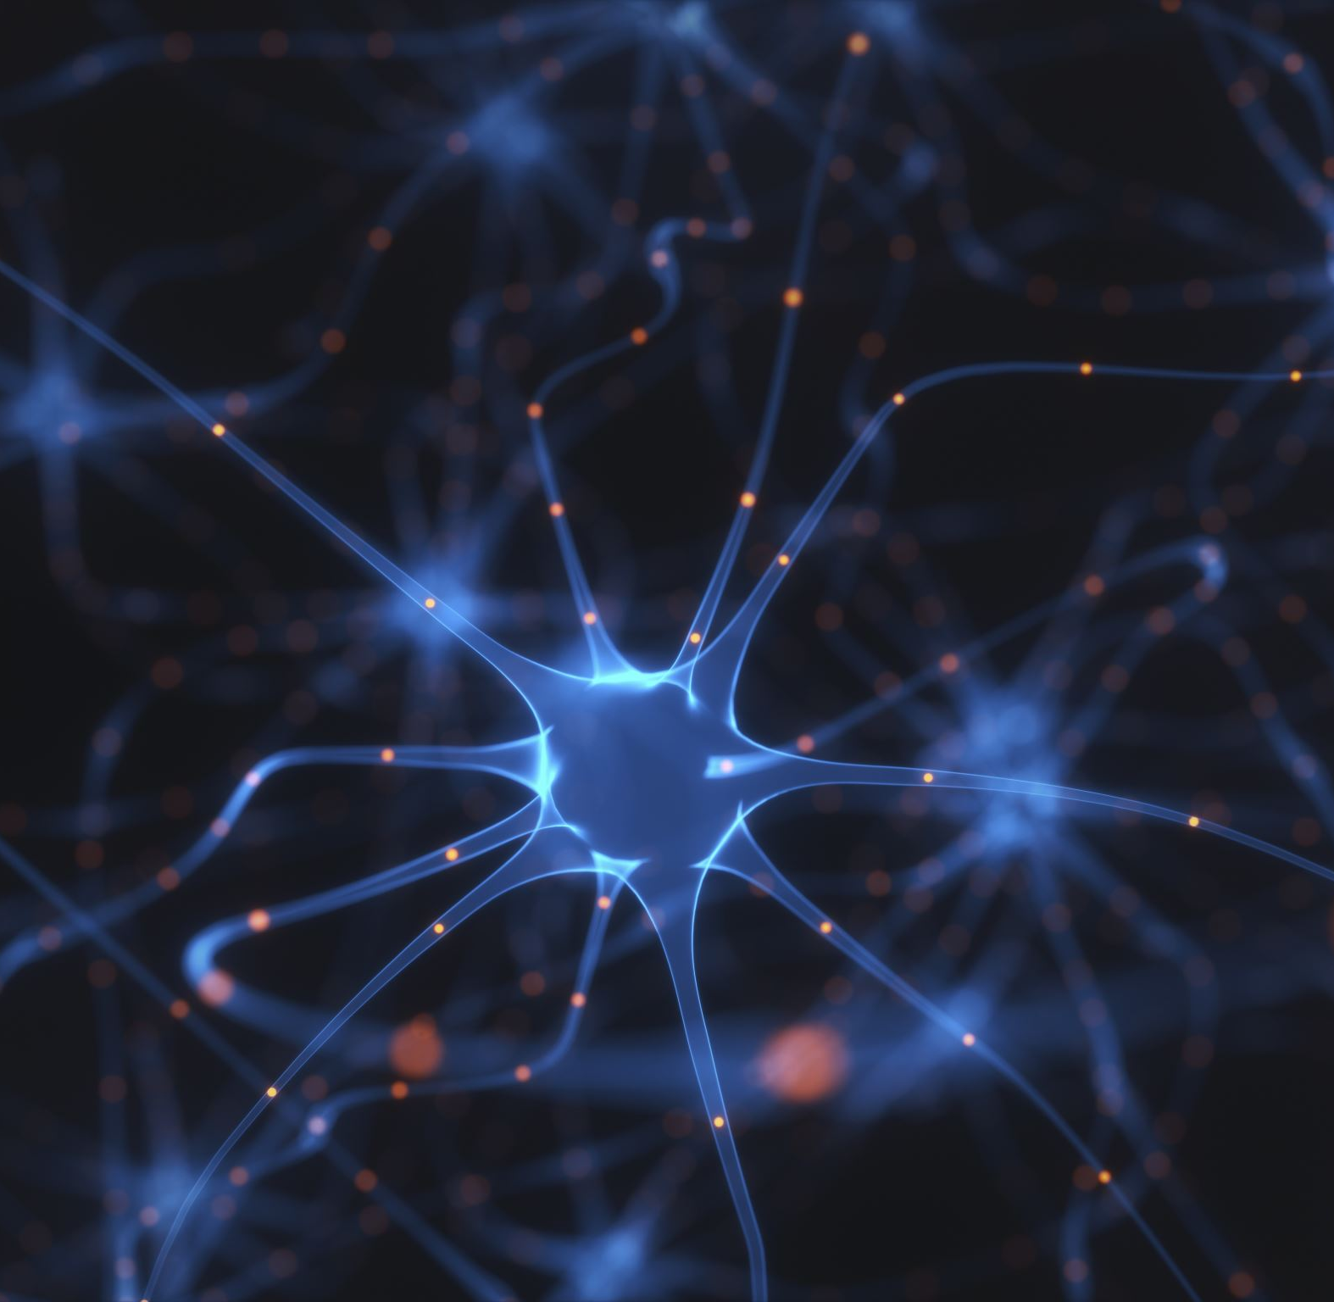
Neuro-inspired computation: Spiking Neural Networks
Hands-on Session on Neucube Platform
by
Aqib Javed

Slide 2

Installation and Working with Neucube
Download and install (https://kedri.aut.ac.nz/R-and-D-Systems/neucube )
Understanding of Dataset
Understanding of Neucube Platform
Encoding using DySNN

Slide 3
Understanding of Dataset
Dataset Type:
Number of samples
Sampling Rate
Number of channel
Dataset file name:
Sam1_XYZ
Sam2_XYZ
Class Label:
tar_class_labels.csv
Each row represent class label
Number of rows=number of sample files
Class Features
feature_names_eeg.txt
Each row represent feature label
Number of rows=number of channels (column in each dataset file)

Slide 4
Now we know a bit of Neucube Lets Proceed with Software
Understanding of Neucube Platform
Encoding using DySNN

